Slide 1

PUBLIC TRANSPORT
OPTIMIZATION
PHASE 3: DEVELOPMENT PART-1

Slide 2
ABSTRACT :
Internet of Things (IoT) is a platform that the device used to be smart, everyday is processed to be smarter, and every day communication becomes more informative.
IoT is still growing and continues to be researched by some researchers. Various models, platforms and applications are proposed and designed in such a way as to benefit society.
This paper was developed using the systematic literature review (SLR) method by conducting surveys on issues oriented towards the utilization of IoT related to the development of intelligent public transport.
The architecture presented proposes solving real-life problems by building and disseminating powerful ideas. The purpose of this study is to explore application of IoT on public transport.

Slide 3
PYTHON SCRIPT :
#define BLYNK_TEMPLATE_ID "TMPL26V4fGv5q"
#define BLYNK_TEMPLATE_NAME "Test"
#define BLYNK_AUTH_TOKEN "XEHxNF_Ur1Nt2p7wB5B20dNI1ZUwj34P"
#include <WiFi.h>
#include <WiFiClient.h>
#include <BlynkSimpleEsp32.h>
int duration1 = 0;
int distance1 = 0;
int duration2 = 0;
int distance2 = 0;
int dis1 = 0;
int dis2 = 0;
int dis_new1 = 0;
int dis_new2 = 0;
int entered = 0;
int left = 0;
int inside = 0;
#define LED 2

Slide 4
#define PIN_TRIG1 15
#define PIN_ECHO1 14
#define PIN_TRIG2 13
#define PIN_ECHO2 12
BlynkTimer timer;
char auth[] = BLYNK_AUTH_TOKEN;
char ssid[] = "Wokwi-GUEST"; // your network SSID (name)
char pass[] = "";
#define BLYNK_PRINT Serial
long get_distance1() {
// Start a new measurement:
digitalWrite(PIN_TRIG1, HIGH);
delayMicroseconds(10);
digitalWrite(PIN_TRIG1, LOW);
// Read the result:
duration1 = pulseIn(PIN_ECHO1, HIGH);
distance1 = duration1 / 58;

Slide 5
return distance1;
}
long get_distance2()
{
// Start a new measurement:
digitalWrite(PIN_TRIG2, HIGH);
delayMicroseconds(10);
digitalWrite(PIN_TRIG2, LOW);
// Read the result:
duration2 = pulseIn(PIN_ECHO2, HIGH);
distance2 = duration2 / 58;
return distance2;
}
void myTimer()
{
Serial.println("100");
dis_new1 = get_distance1();
dis_new2 = get_distance2();

Slide 6
if (dis1 != dis_new1 || dis2 != dis_new2)
{
Serial.println("200");
if (dis1 < dis2)
{
Serial.println("Enter loop");
entered = entered + 1;
inside = inside + 1;
digitalWrite(LED, HIGH);
Blynk.virtualWrite(V0, entered);
Blynk.virtualWrite(V2, inside);
dis1 = dis_new1;
delay(1000);
digitalWrite(LED, LOW);
}
if (dis1 > dis2)
{
Serial.println("Leave loop");
left = left + 1;
inside = inside - 1;
Blynk.virtualWrite(V1, left);
Blynk.virtualWrite(V2, inside);dis2 = dis_new2;
delay(1000);
}

Slide 7
}
}
void setup()
{
Serial.begin(115200);
pinMode(LED, OUTPUT);
pinMode(PIN_TRIG1, OUTPUT);
pinMode(PIN_ECHO1, INPUT);
pinMode(PIN_TRIG2, OUTPUT);
pinMode(PIN_ECHO2, INPUT);
Blynk.begin(auth, ssid, pass, "blynk.cloud", 8080);
timer.setInterval(1000L, myTimer);
}
void loop()
{
Blynk.run();
timer.run();
}

Slide 8
DIAGRAM CODE :
{
"version": 1,
"author": "MANOJ S",
"editor": "wokwi",
"parts": [
{"type":"wokwi-esp32-devkit-v1","id":"esp","top": -12.8,"left": 180.8, "attrs": {} },
{
"type": "wokwi-hc-sr04",
"id": "ultrasonic1",
"top": -31.94,
"left": -1.1,
"attrs": { "distance": "240" }
},
{
"type": "wokwi-hc-sr04",
"id": "ultrasonic2",
"top": -32.14,

Slide 9
"left": -184.37,
"attrs": { "distance": "104" }
},
{
"type": "wokwi-led",
"id": "led1",
"top": 196.6,
"left": 95.24,
"attrs": { "color": "red" }
}
],
"connections": [
[ "esp:TX0", "$serialMonitor:RX", "", [] ],
[ "esp:RX0", "$serialMonitor:TX", "", [] ],
[ "ultrasonic1:VCC", "esp:VIN", "red", [ "v0" ] ],
[ "ultrasonic1:GND", "esp:GND.2", "black", [ "v0" ] ],
[ "ultrasonic1:TRIG", "esp:D13", "green", [ "v0" ] ],
[ "ultrasonic1:ECHO", "esp:D12", "green", [ "v0" ] ],

Slide 10
["ultrasonic2:GND","esp:GND.2","black",["v93.61","h255.99","v-19.13", "h1.42"]],
[ "ultrasonic2:VCC", "esp:VIN", "red",["v111.32", "h288.11", "v-26.93"] ],
[ "ultrasonic2:ECHO", "esp:D14", "green",["v97.15","h262.44","v-53.14"] ],
[ "ultrasonic2:TRIG", "esp:D15", "green",["v102.11","h397.16","v-36.14"] ],
[ "led1:C", "esp:GND.1", "black",[ "v7.36", "h195.18", "v-106.29" ] ],
[ "led1:A", "esp:D22", "green",[ "v0.98","h178.81","v-149.51"]]
],
"dependencies": {}
}

Slide 11
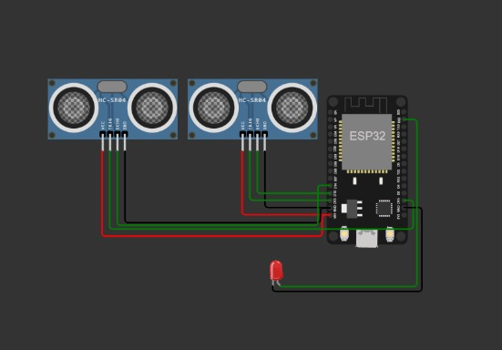
IOT DEVICE :

Slide 12
THANK YOU
THESE CODE AND DIAGRAM ARE INCLUDED IN PHASE 3 : PUBLIC TRANSPORT OPTIMIZATION SYSTEM.
PRESENTED BY :
PAVITHRA K
422621104031
UNIVERSITY COLLEGE OF ENGINEERING,PANRUTI.

